Slide 1
DormEase
Presented By
Rakib Ahsan
1905024
Al-Amin Sany
1905048
Bijoy Ahemd Saiem
1905052
Group Information
Subsection: A2
Group ID: 2

Slide 2
contents
Login
Newsfeed
Notice Board
Complaint Box
Dining management
Seat Allocation Information

Slide 3
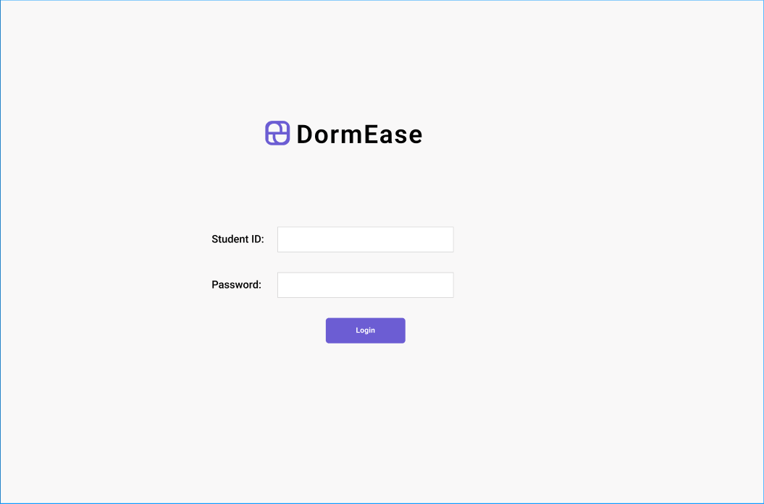
Login page

Slide 4
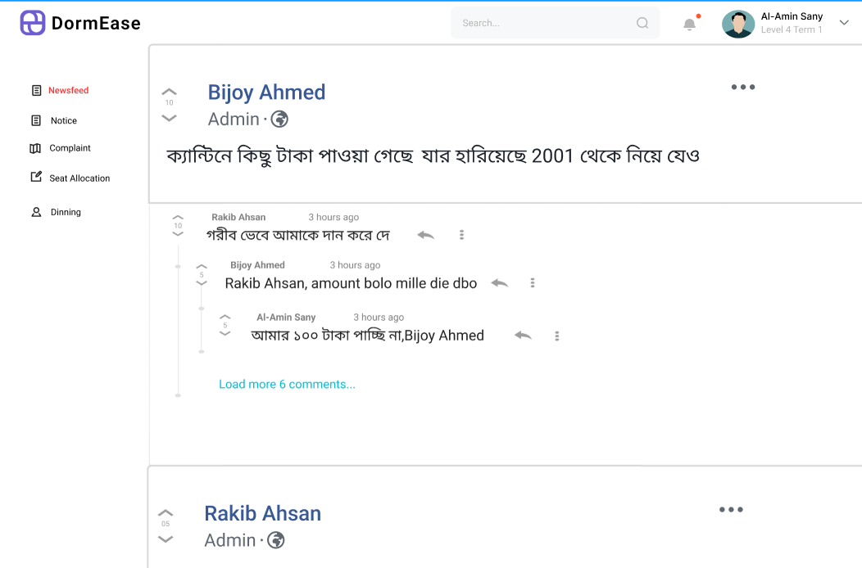
NewsFeed

Slide 5
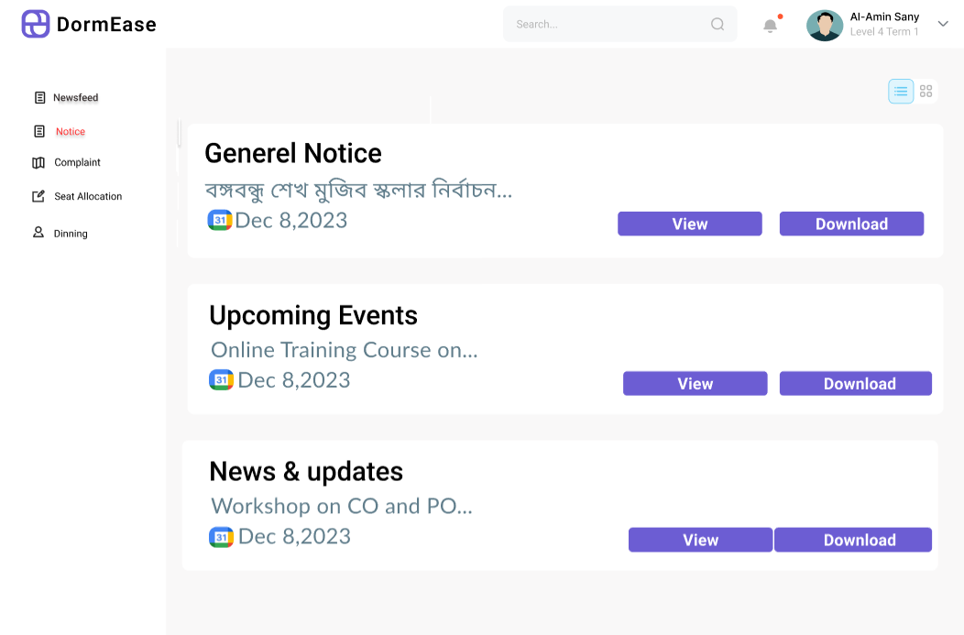
Notice board

Slide 6
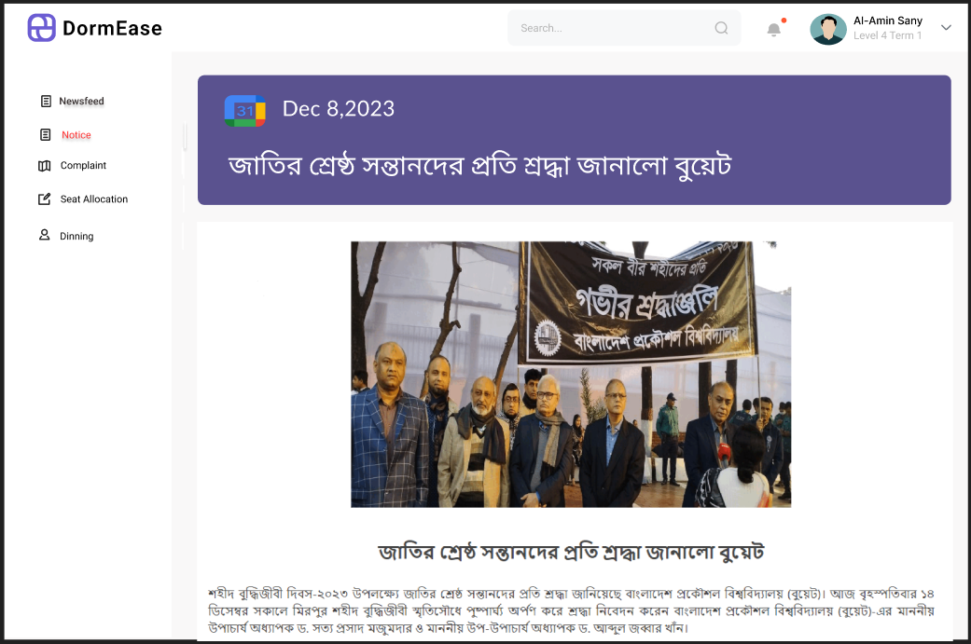
Notice

Slide 7
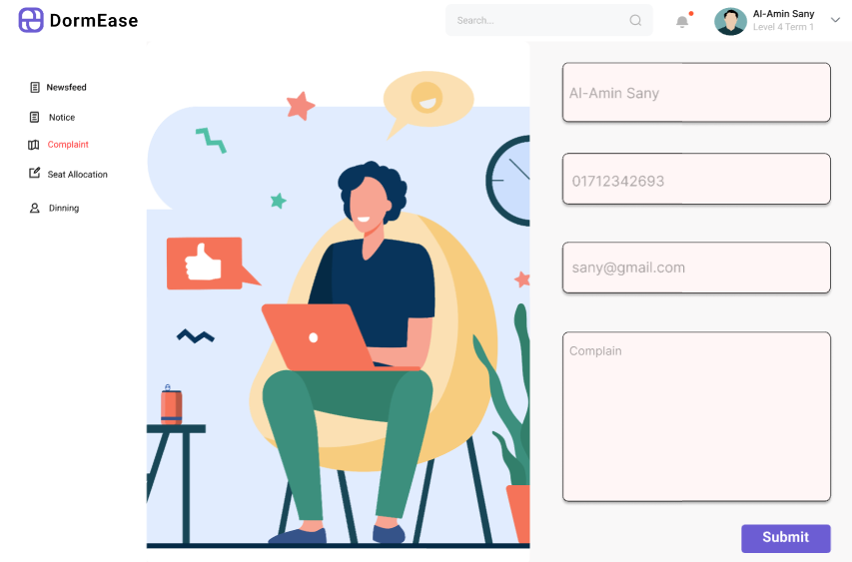
Complaint Box (1)

Slide 8
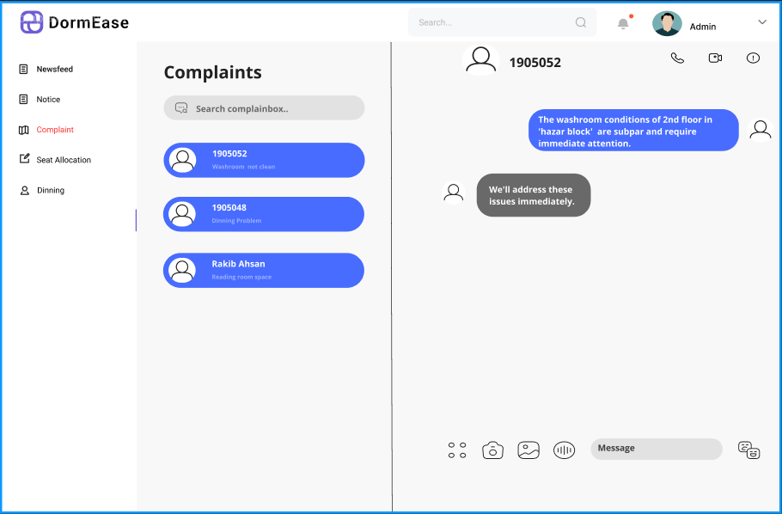
Complaint Box (2)

Slide 9
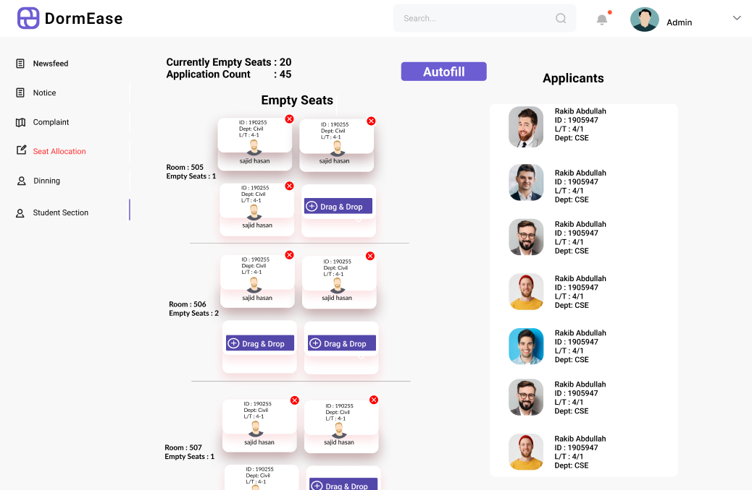

Seat allocation

Slide 10
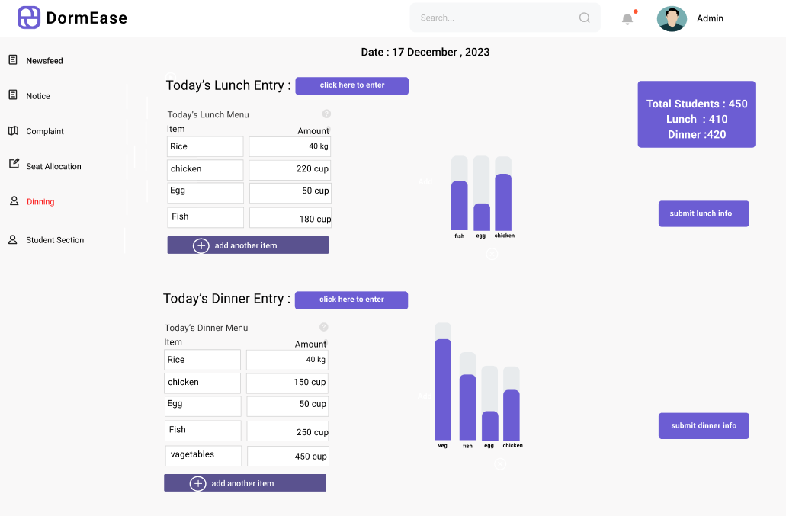
Dinning management

Slide 11
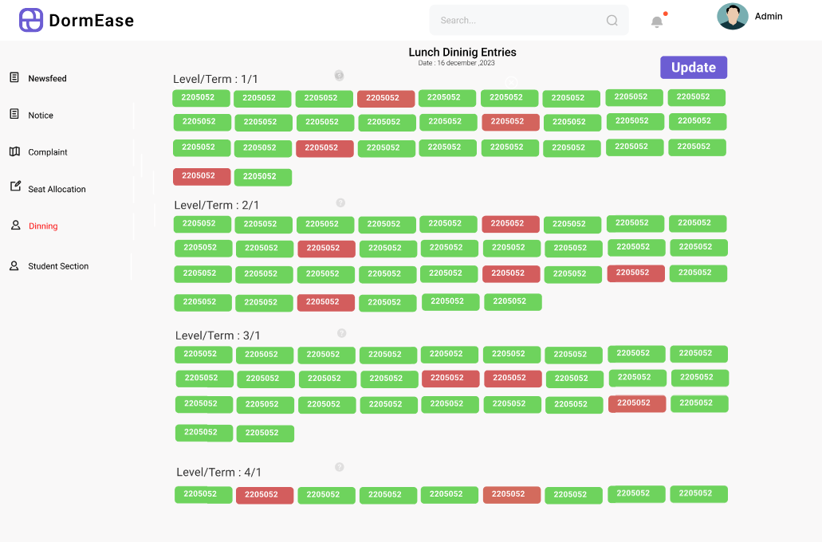
Dining entries

Slide 12
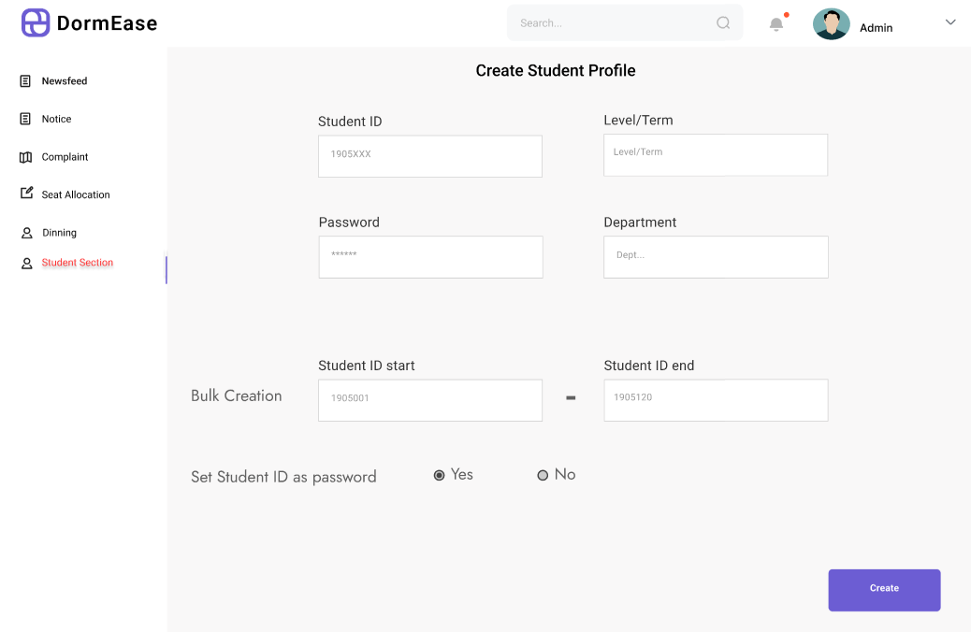
student section for admin

Slide 13
Thank YOu

